Slide 1
5 Introduction to software change
Software change (SC) is the process of adding new functionality to existing code
Foundation of software evolution, servicing
© 2012 Václav Rajlich Software Engineering: The Current Practice Ch. 5

Slide 2
Characteristics of SC
Lientz and Swanson, 1980
  perfective ~66%
  adaptive
  corrective
  protective
© 2012 Václav Rajlich Software Engineering: The Current Practice Ch. 5

Slide 3
Functionality
Incremental
  adding new functionality
Contraction
  removing obsolete functionality
Replacement
  replacing existing functionality
Refactoring
  changing software structure without changing behavior
© 2012 Václav Rajlich Software Engineering: The Current Practice Ch. 5

Slide 4
Impact
Local impact
Significant impact
Massive impact
Change strategy
  improves structure
  quick fix
© 2012 Václav Rajlich Software Engineering: The Current Practice Ch. 5

Slide 5
Form of changing code
Source code
  most common
Code after compilation
  object form
  executable form
© 2012 Václav Rajlich Software Engineering: The Current Practice Ch. 5

Slide 6
Phased model of SC
Initiation
Concept Location
Main topic of this course
Preview of Phases of SC
Impact Analysis
V
E
R
I
F
I
C
A
T
I
O
N
Prefactoring
Interactions with the world
Actualization
SC design
Postfactoring
SC Implementation
Conclusion
© 2012 Václav Rajlich Software Engineering: The Current Practice Ch. 5

Slide 7
Initiation
Initiation
Concept Location
SC starts by a change request
Prioritization of change requests, etc.
Impact Analysis
V
E
R
I
F
I
C
A
T
I
O
N
Prefactoring
Actualization
Postfactoring
Conclusion
© 2012 Václav Rajlich Software Engineering: The Current Practice Ch. 5

Slide 8
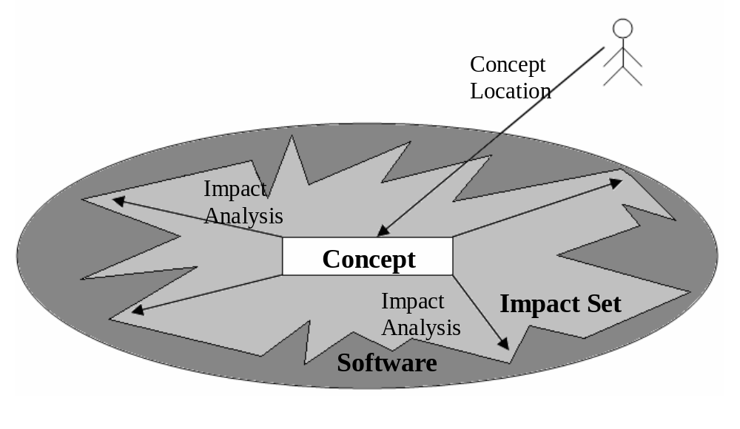
SC Design
Initiation
Concept Location
Impact Analysis
V
E
R
I
F
I
C
A
T
I
O
N
Prefactoring
Actualization
Postfactoring
Conclusion
© 2012 Václav Rajlich Software Engineering: The Current Practice Ch. 5

Slide 9
Concept Location
Initiation
Concept Location
Concepts are extracted from change request
Extracted concepts are located in the code and used as a starting point of SC
Impact Analysis
V
E
R
I
F
I
C
A
T
I
O
N
Prefactoring
Actualization
Postfactoring
Conclusion
© 2012 Václav Rajlich Software Engineering: The Current Practice Ch. 5

Slide 10
Impact Analysis
Initiation
Concept Location
Determine strategy and impact of change
Classes identified in concept location make up the initial impact set
Class dependencies are analyzed, and impacted classes are added to the impact set
Impact Analysis
V
E
R
I
F
I
C
A
T
I
O
N
Prefactoring
Actualization
Postfactoring
Conclusion
© 2012 Václav Rajlich Software Engineering: The Current Practice Ch. 5

Slide 11
Prefactoring
Initiation
Concept Location
Opportunistic refactoring that localizes (minimizes) impact of SC on software
Extract Class
  gather fields, methods, and code snippets into a new component class
Extract Superclass
  create new abstract class
Impact Analysis
V
E
R
I
F
I
C
A
T
I
O
N
Prefactoring
Actualization
Postfactoring
Conclusion
© 2012 Václav Rajlich Software Engineering: The Current Practice Ch. 5

Slide 12
Actualization
Initiation
Concept Location
Creates new code
Plugs it into the old code
Visit neighboring classes and update them
  change propagation
  ripple effect
Impact Analysis
V
E
R
I
F
I
C
A
T
I
O
N
Prefactoring
Actualization
Postfactoring
Conclusion
© 2012 Václav Rajlich Software Engineering: The Current Practice Ch. 5

Slide 13
Postfactoring
Initiation
Concept Location
Eliminate any anti-patterns that may have been introduced
  “long method”
    after added functionality, some methods may be doing too much
  “bloated class”
    after added functionality, a class may be too large
Impact Analysis
V
E
R
I
F
I
C
A
T
I
O
N
Prefactoring
Actualization
Postfactoring
Conclusion
© 2012 Václav Rajlich Software Engineering: The Current Practice Ch. 5

Slide 14
Verification
Initiation
Concept Location
Guarantees correctness of the change
Testing
  functional
  unit
  structural
Walkthroughs
Impact Analysis
V
E
R
I
F
I
C
A
T
I
O
N
Prefactoring
Actualization
Postfactoring
Conclusion
© 2012 Václav Rajlich Software Engineering: The Current Practice Ch. 5

Slide 15
Conclusion
Initiation
Concept Location
Commit finished code into version control
Build the new baseline
Prepare for the next change
Impact Analysis
V
E
R
I
F
I
C
A
T
I
O
N
Prefactoring
Actualization
Postfactoring
Conclusion
© 2012 Václav Rajlich Software Engineering: The Current Practice Ch. 5

Slide 16
Test-Driven
Development
Initiation
Write test first
Write code to pass the test
Concept Location
Test-first
Actualization
Regression testing
New Baseline
© 2012 Václav Rajlich Software Engineering: The Current Practice Ch. 5

Slide 17
Change initiation
Initiation
Concept Location
Requirements
  user reports a software bug
  user asks for an enhancement
  programmer proposes improvement
  manager wants to meet competitor’s functionality
Impact Analysis
V
E
R
I
F
I
C
A
T
I
O
N
Prefactoring
Actualization
Postfactoring
Conclusion
© 2012 Václav Rajlich Software Engineering: The Current Practice Ch. 5

Slide 18
Form of Change Requirements
Sentence or paragraph
User story
  limit the complexity of the story and potential for misunderstanding
  user story fits on a 3” x 5” card
  if a new functionality cannot fit, it has to be divided into several user stories
Bug report
© 2012 Václav Rajlich Software Engineering: The Current Practice Ch. 5

Slide 19
Sample User Stories
A bank customer can change their PIN.
As a student, I can find my grades online so that I don’t have to wait until the next day to know whether I passed.
One level of undo
As a book shopper, I can read reviews of a selected book to help me decide whether to buy it.
As an author, I want the spell checker to ignore words with numbers so that only truly misspelled words are indicated.
© 2012 Václav Rajlich Software Engineering: The Current Practice Ch. 5

Slide 20
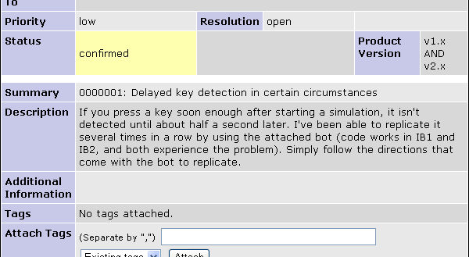
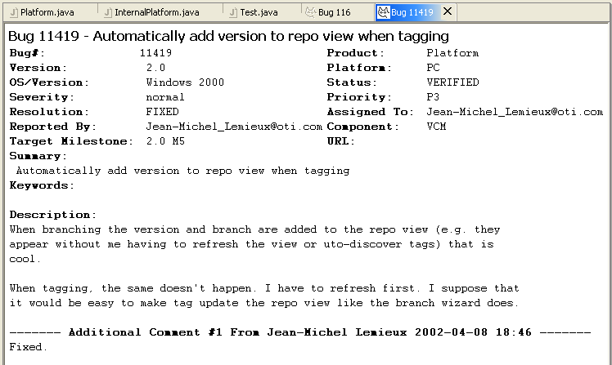
© 2012 Václav Rajlich Software Engineering: The Current Practice Ch. 5

Slide 21
Product backlog
Database of requirements
  “wish list”
  add/delete/modify requirements
  additional knowledge is acquired by the users
  additional clarification is needed by the developers
© 2012 Václav Rajlich Software Engineering: The Current Practice Ch. 5

Slide 22
Requirements Elicitation
Requirements
elicitation
New Requirements
Product Backlog
Desired Code
Stakeholders
Existing Code
© 2012 Václav Rajlich Software Engineering: The Current Practice Ch. 5

Slide 23
Requirements analysis
Inconsistencies
  Contradictions
    ex. different formula for the same thing
  Inadequacy
    ex. requirements are too terse -> developers have to guess
© 2012 Václav Rajlich Software Engineering: The Current Practice Ch. 5

Slide 24
Inconsistencies (2)
Noise
    ex. irrelevant requirements (delete them)
Infeasibility
    ex. project team or technology barriers
Ambiguity or unintelligibility
    ex. interpreting a requirement in more than one way
© 2012 Václav Rajlich Software Engineering: The Current Practice Ch. 5

Slide 25
Prioritization - bugs
Fatal application error
Application is severely impaired
  no workaround can be found
Some functionality is impaired
  workaround can be found
Minor problem
  not involving primary functionality
© 2012 Václav Rajlich Software Engineering: The Current Practice Ch. 5

Slide 26
Business value
An essential functionality without which the application is useless
An important functionality that users rely on
A functionality that users need but can be without
A minor enhancement
© 2012 Václav Rajlich Software Engineering: The Current Practice Ch. 5

Slide 27
Risk
A serious threat, the so-called “showstopper”
  if unresolved, the project is in serious trouble
An important threat that cannot be ignored
A distant threat that still merits attention
A minor inconveniences
© 2012 Václav Rajlich Software Engineering: The Current Practice Ch. 5

Slide 28
Process needs
Key requirement
  if not implemented in advance, practically all code will have to be redone
An important requirement
  if postponed, will lead to large rework
A nontrivial rework will be required if this requirement is postponed
A minor rework will be triggered
© 2012 Václav Rajlich Software Engineering: The Current Practice Ch. 5

Slide 29
Change Initiation process
Select a set of the highest priority requirements
Analyze these requirements
After this analysis, select the highest priority requirement as the next change request
© 2012 Václav Rajlich Software Engineering: The Current Practice Ch. 5

Slide 30
Change Initiation
Product Backlog
Desired Code
Change Initiation
Change
Change
Request
New Code
Stakeholders
Existing Code
© 2012 Václav Rajlich Software Engineering: The Current Practice Ch. 5

